Slide 1
Spring MVC 102
September 19, 2016

Slide 2
MVC Architecture
Spring Web MVC Features
Core Components of Spring MVC
Lifecycle of a Request in Spring MVC
Defining a Controller
Mapping Requests
View Resolvers
@ExceptionHandler annotation
Apache Tiles and Spring MVC
Introduction to JSTL

Slide 3
Objectives
Understanding MVC Architecture
Understanding Spring Web MVC Features
Understanding Lifecycle of a Request in Spring MVC
Understanding controller, request and view resolver
Understanding Apache Tiles and Spring MVC
Introduction to JSTL

Slide 4
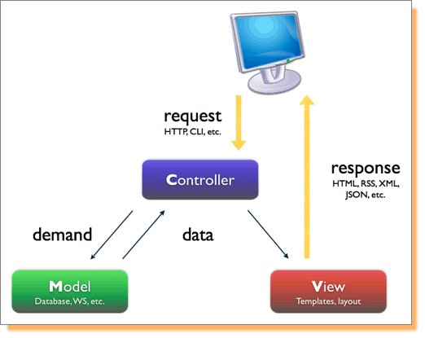
Let us revise
MVC Architecture
Notes:
4

Slide 5
Spring Web MVC Features
Uses single front controller design pattern.
A clear separation between different components compare to struts2
Customizable locale and theme resolution
Request routing is completely controlled by the front controller
A simple yet powerful JSP tag library known as the Spring tag library that provides support for features such as data binding and themes.
A JSP form tag library, introduced in Spring 2.0, that makes writing forms in JSP pages much easier.
It can be integrated with various other view technology like jsp , tiles , velocity , freemarker etc.
Individual controllers can be used to handle different requests
Controllers are POJOs
All Spring MVC components are configured and managed via the Spring ApplicationContext
Notes:
Clean separation is that
5

Slide 6
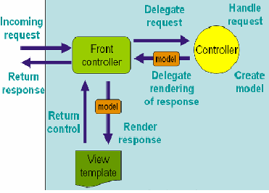
Core Components of Spring MVC
DispatcherServlet
Front Controller for Spring
Controllers
User created components for
handling requests
Encapsulates the navigation logic
Delegates to service layer for
business logic
View
Responsible for rendering the
output
Notes:
6

Slide 7
Core Components of Spring MVC (Contd..)
ModelAndView
Created by the Controller
Stores the Model data
Associates a view to the request
Physical implementation or logical view name
ViewResolver
Mapping between logical view names and actual implementations
HandlerMapping
Interface used by DispatcherServlet to map request with controllers
Notes:
7

Slide 8
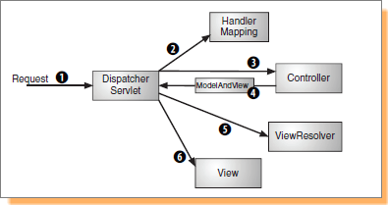
Lifecycle of a Request in Spring MVC
DispatcherServlet acts as the front controller to receive all requests
DispatcherServlet refers to the HandlerMapping to find the respective Controller to handle the request
The request is sent to the identified Controller. The Controller processes this request (or delegates the responsibility of performing business logic to the service objects) and creates a response – ModelAndView
The request along with the response (ModelAndView) is sent back to the DispatcherServlet
The DispatcherServlet uses the ViewResolver to find the actual view implementation (e.g. JSP)
The model data is sent to the view ( e.g. JSP) which renders and displays the response
Notes:
8

Slide 9
Problem Statement
We need to create a “Student Registration Portal” web application, where the administrator logs in sees two links one to register new students and other to view the registered student.

Slide 10
Lets solve this problem Step by Step using Spring MVC
First we need to create a Dynamic Web application using Maven and add the following dependencies.
<dependency>
<groupId>org.springframework</groupId>
<artifactId>spring-webmvc</artifactId>
<version>3.1.2.RELEASE</version>
</dependency>
<dependency>
<groupId>jstl</groupId>
<artifactId>jstl</artifactId>
<version>1.2</version>
</dependency>

Slide 11
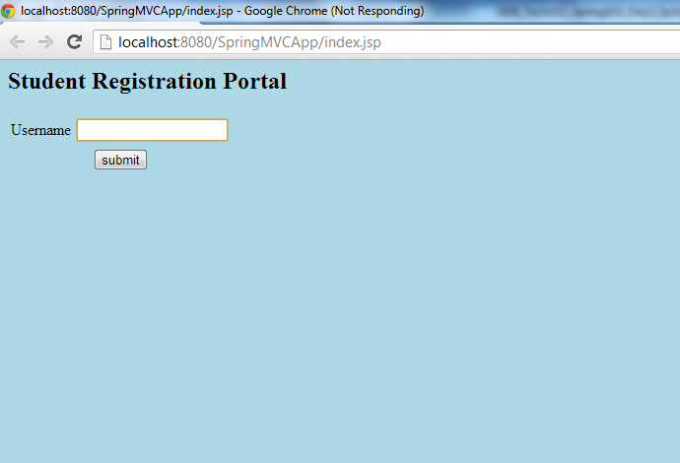
Let us add a index.jsp page as shown below

Slide 12
Configuring the DispatcherServlet
DispatcherServlet is declared in the <servlet> declaration of the web.xml
When DispatcherServlet is loaded, it also loads the spring application context from [servlet-name]-servlet.xml
In the above example the application context is loaded from file spring-mvc-servlet.xml
All the requests ending with .htm will be handled by this DispatcherServlet (spring-mvc)
<servlet>
<servlet-name>spring-mvc</servlet-name>
<servlet-class>
org.springframework.web.servlet.DispatcherServlet
</servlet-class>
<load-on-startup>1</load-on-startup>
</servlet>
<servlet-mapping>
<servlet-name>spring-mvc</servlet-name>
<url-pattern>*.htm</url-pattern>
</servlet-mapping>
Notes:
12

Slide 13
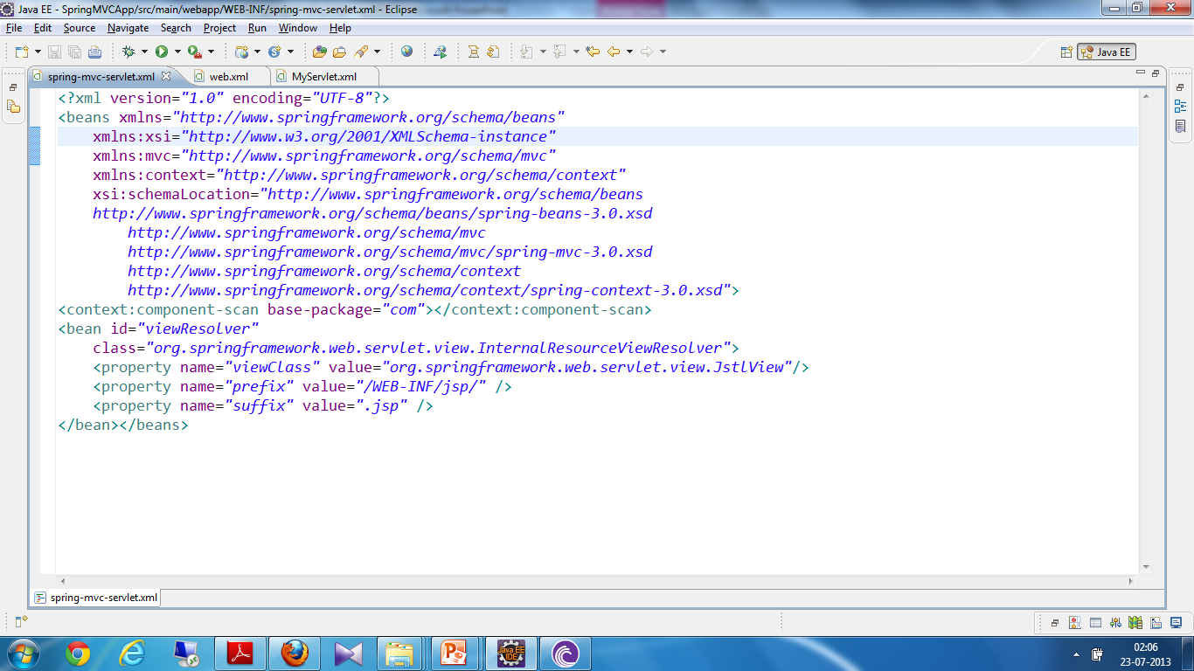
Configuring the applicationContext
Next Step is to configure the Context file and name it as spring-mvc-servlet.xml
which should be placed in WEB-INF folder.
View Resolver – to provide the mapping between view names and the actual views
to specify the base package which will be scanned for the spring controller annotations
Notes:
13

Slide 14
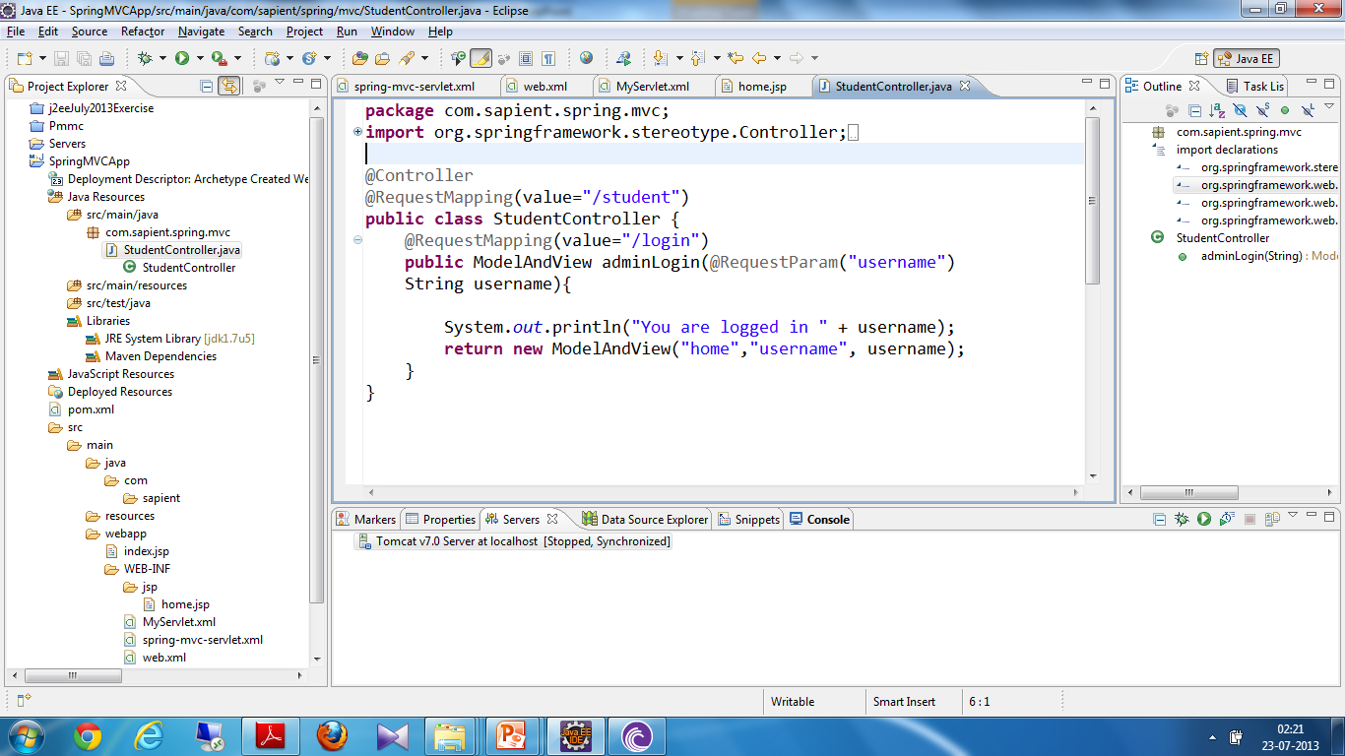
Creating the Handlers
Next Step is to Create a Request handler say StudentController for handling the request coming from index.jsp
Annotation enables this class to act as a controller or handler.
Annotation provides name that can be used in the url to invoke this controller
Returning an object of ModelAndView and providing the logical name of the view(home) as well as data(username) which can be utilized in the view
Annotation helps us to get the request parameters

Slide 15
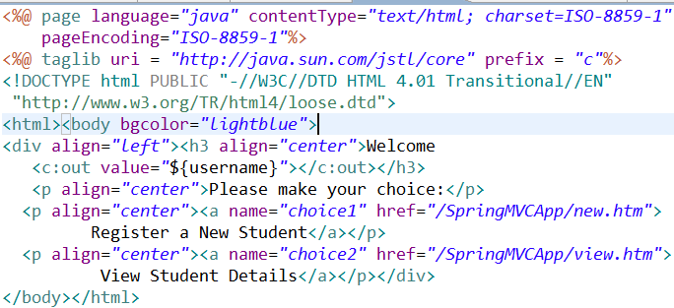
creating a view
Including a jstl taglib for using the special tags to display the model data in this view
Next step is to create a view home.jsp to display the data to the user
using jstl tag to read the model data and display it to user
Notes:
Bean Factory is the implementation of the factory design pattern, which is responsible for creating and disposable of beans.
Because a bean factory knows about many objects within an application, it is able to create associations between collaborating objects as they are instantiated.
when a bean factory hands out objects, those objects are fully configured, are aware of their collaborating objects, and are ready to use
A bean factory also takes part in the lifecycle of a bean, making calls to custom initialization and destruction methods, if those methods are defined.
Beans are “lazily” loaded into bean factories, meaning that while the bean factory will immediately load the bean definitions, the beans themselves will not be instantiated until they are needed.
Resource is only an interface, while ClassPathResource is one of its implementations for loading a resource from the classpath. Other implementations of the Resource interface, such as FileSystemResource, InputStreamResource, and UrlResource, are used to load a resource from other locations
Next, you can use the following statement to instantiate a bean factory by passing in a Resource object with the configuration file loaded:
BeanFactory factory = new XmlBeanFactory(resource);

Slide 16
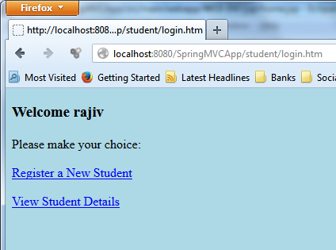
Finally the View is Shown to the user

Slide 17
Exercise : Coding
Create an web app for admin login which accept a username and password and then display a home page saying welcome “username” and display the page to display two links :-
To register the new user
To view the registered user
Register should open a registration page and accepts the registration of a new user.
View page should show the user who is regsitered with previous step.
Notes:
Steps to setup Spring for your project –
1) Download and unzip the Spring api from www.springsource.org/download
2) In your project add references for the following jar files(atleast) in the build path
a – spring.jar
b – commons-logging.jar
3) Create a java project
4) Add an xml file anywhere in the hierarchy of the source folder
5) Initialize the ApplicationContext or the BeanFactory to read that xml file and start creating beans.

Slide 18
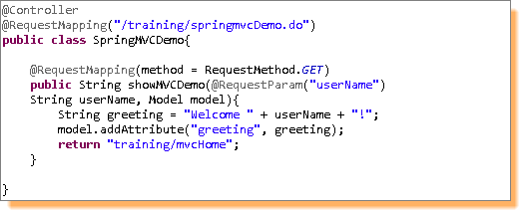
Defining a Controller
Acts as interface to the application
Interprets input and transforms into response (model)
@Controller stereotype allows auto-detection
Any class can act as a Controller
Notes:
18

Slide 19
Mapping Requests
To map the urls to handlers
Using @RequestMapping annotation
Class level & Method level
Notes:
- Typically the class-level annotation maps a specific request path (or path pattern) onto a form controller, with additional method-level annotations narrowing the primary mapping for a specific HTTP method request method ("GET"/"POST") or specific HTTP request parameters
19

Slide 20
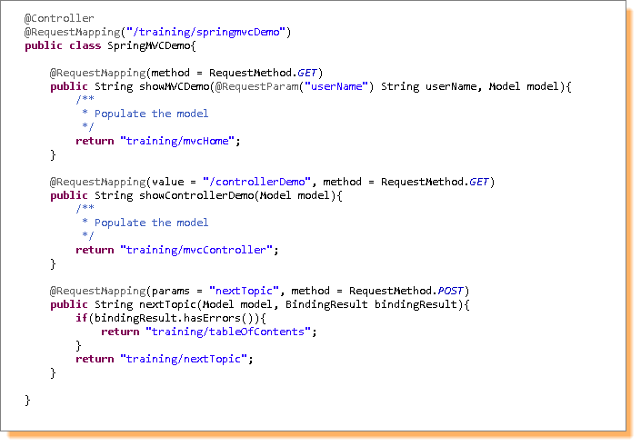
Usage of @RequestMapping
Notes:
Class level annotation indicates that all handling methods in this controller are relative to the “/training/springmvcDemo” path
The “showMVCDemo” method further refines the request mapping to GET requests
“showControllerDemo” method will handle the GET requests for “/training/springmvcDemo/controllerDemo”
“nextTopic” method will handle Http POST requests with parameter “nextTopic” in the request.
Note: @RequestMapping at class level is not required. Without it, all paths are absolute and not relative.
20

Slide 21
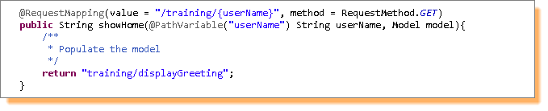
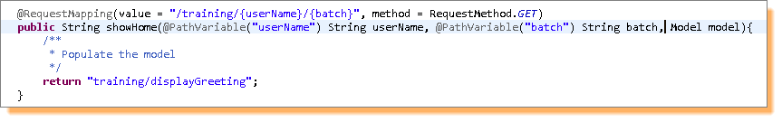
@RequestMapping – Method Argument Types
URI Template
To access parts of URL in handling methods
@PathVariable
Multiple URI Template variables
Notes:
A URI Template is a URI-like string, containing one or more variable names
@PathVariable method parameter annotation to indicate that a method parameter should be bound to the value of a URI template variable
21

Slide 22
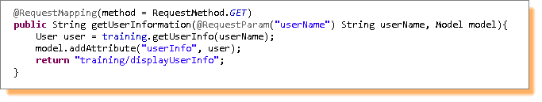

@RequestMapping – Method Argument Types (Contd.)
@RequestParam
Binds query parameters to method parameters
Parameters can be required (default) or optional
Notes:
A URI Template is a URI-like string, containing one or more variable names
@PathVariable method parameter annotation to indicate that a method parameter should be bound to the value of a URI template variable
22

Slide 23
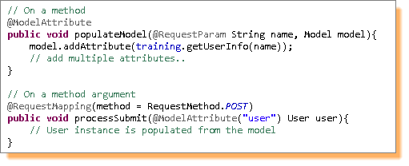
@RequestMapping – Method Argument Types (Contd.)
@ModelAttribute
Can be used on methods or method arguments
On a method it indicates the purpose of the method is to add one or more model attributes
@ModelAttribute methods in a controller are called before @RequestMapping methods within the same controller
@ModelAttribute methods are used to populate the model with commonly needed attributes e.g. Drop-down lists
On a method argument indicates the argument should be retrieved from the model
Once present in the model, the argument's fields should be populated from all request parameters that have matching names (this is referred to as data-binding)
Notes:
23

Slide 24
@RequestMapping – Method Argument Types (Contd.)
@SessionAttributes
Declares session attributes used by a specific handler
Typically list the names of model attributes or types of model attributes which should be transparently stored in the session
Serves as form-backing beans between subsequent requests
Notes:
24

Slide 25
@RequestMapping – Method Return Types
Following return types are supported by @RequestMapping handler methods:
A ModelAndView object, with the model implicitly enriched with command objects and the results of @ModelAttribute annotated reference data accessor methods
A Model object, with the view name implicitly determined through a RequestToViewNameTranslator and the model same as above
A View object, with the model implicitly determined through command objects and @ModelAttribute annotated reference data accessor methods
A String value that is interpreted as the logical view name
void if the method handles the response itself (by writing the response content directly or if the view name is supposed to be implicitly determined through a RequestToViewNameTranslator
Any other return type is considered to be a single model attribute to be exposed to the view
Notes:
25

Slide 26
View Resolvers
View Resolvers enable you to render models in a browser without tying you to a specific view technology
Examples of view technologies that can be used – JSPs, Velocity templates, XSLT views etc.
Two important interfaces:
ViewResolver – Provides a mapping between view names and actual views
View – Prepares the request and hands it to one of the view technologies
Notes:
26

Slide 27
Resolving views with ViewResolver interface
All handler methods in the Spring Web MVC controllers must resolve to a logical view name
Common View Resolvers provided by Spring:
ViewResolver | Description
AbstractCachingViewResolver | Abstract view resolver that caches views
XmlViewResolver | Implementation of ViewResolver that accepts a configuration file written in XML. The default configuration file is /WEB-INF/views.xml
ResourceBundleViewResolver | Implementation of ViewResolver that uses bean definitions in a ResourceBundle, specified by the bundle base name. The default file name is views.properties.
UrlBasedViewResolver | Resolves logical view names to URLs, without an explicit mapping definition.
InternalResourceViewResolver | Subclass of UrlBasedViewResolver that supports InternalResourceView (in effect, Servlets and JSPs) and subclasses such as JstlView and TilesView.
Notes:
27

Slide 28
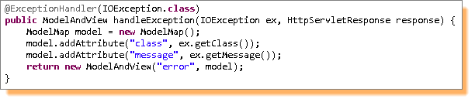
@ExceptionHandler annotation
A method annotated with @ExceptionHandler will be invoked when an exception of a specific type occurs during the execution of the controller (in which the method resides)
The value in @ExceptionHandler can be a list of exceptions, for which the method will be invoked
If no value is specified the exception types in method arguments are used.
Notes:
28

Slide 29
Exercise | Exception Handling
Use the Registration exercise and add a link to update a user and delete the user.
When user tries to update the user without registration then should handle the exceptional
scenario
Notes:
29

Slide 30

Apache Tiles and Spring MVC
Tiles is a templating framework built to simplify the development of web application user interfaces.
Tiles allows authors to define page fragments which can be assembled into a complete page at runtime.
Tiles helps developers create re-usable templates, which can be used to streamline the development of a consistent look and feel across an entire application.

Slide 31
Apache Tiles – How to add tiles support to Spring MVC project?
Add the following dependencies in your pom.xml.
<dependency>
<groupId>org.apache.tiles</groupId>
<artifactId>tiles-core</artifactId>
<version>2.2.1</version>
</dependency>
<dependency>
<groupId>org.apache.tiles</groupId>
<artifactId>tiles-jsp</artifactId>
<version>2.2.1</version>
</dependency>
<dependency>
<groupId>org.slf4j</groupId>
<artifactId>slf4j-jdk14</artifactId>
<version>1.5.8</version>
</dependency>

Slide 32
Change your view resolver entry in spring-mvc-servlet.xml as follows.
<bean id="viewResolver“ class="org.springframework.web.servlet.view.UrlBasedViewResolver">
<property name="viewClass">
<value> org.springframework.web.servlet.view.tiles2.TilesView </value>
</property>
</bean>
Add following bean to configure tiles.
<bean id="tilesConfigurer" class="org.springframework.web.servlet.view.tiles2.TilesConfigurer">
<property name="definitions">
<list>
<value>/WEB-INF/tiles.xml</value>
</list>
</property>
</bean>

Slide 33
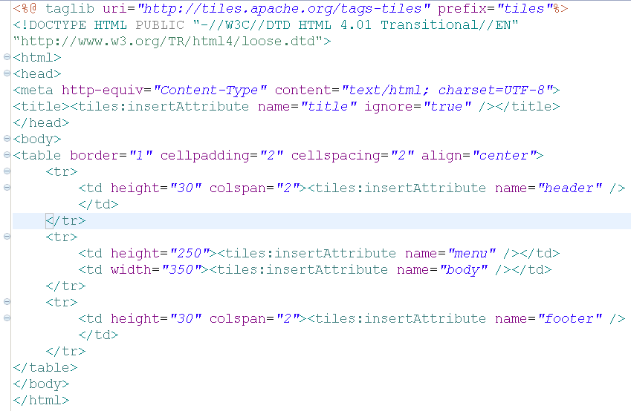
Use the tiles taglib
Create a layout definition file (baseLayout.jsp file).
Use the tiles tags to define the fillers which will be dynamically updated using the tiles configuration
Notes:
The <tiles:insertAttribute> tag is used to define the placeholders which will be filled or the content would be added dynamically using the tiles configuration defined in the tiles.xml file.
In the example above using the table tags, the placeholders have been defined in a manner which will resemble a page layout having a header, left menu, body and a footer.

Slide 34
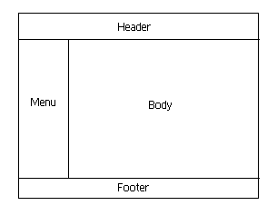
Apache Tiles – How to? (contd..)
This is how the base layout looks – and the placeholders have been marked in the layout, to give a general idea of how the layout would be rendered.
Now this layout can be used in the tiles configuration file, where different value –either text or path to an html or jsp file can be assigned to the placeholders.

Slide 35
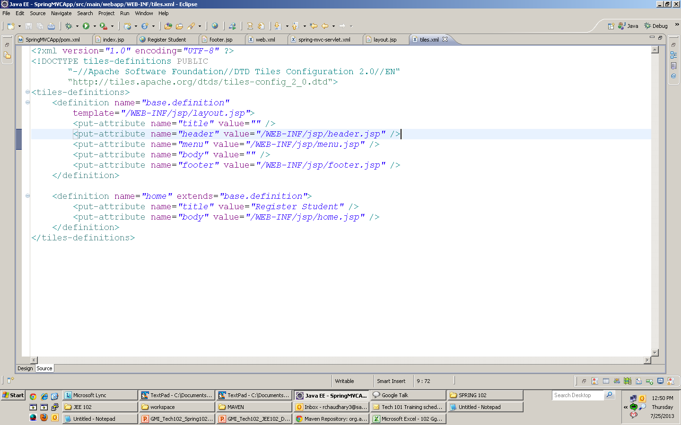
Create the tiles configuration file - tiles.xml in WEB-INF folder of your application
A Typical tiles configuration looks like this –
This is the first definition and it uses the layout jsp as the template
DOCTYPE: tiles dtd
Then we assign values for placeholders
We can extend the definitions and can over-ride particular placeholders
Notes:
The definition tag is used to create a definition and we can -
either choose to create a new definition by assigning a template to it , and giving values for all placeholders
or we can extend an existing definition by using extends attribute. And just give values for some specific placeholders as we did for definitions – buy, sellStockPage, showTransactions.
A definition is a layer between a layout page and a JSP using the layout. In Spring MVC a Tiles definition corresponds to a view.
The view is normally a JSP, but Velocity or FreeMarker can also be used.
By analogy, a layout page is like a Java interface and a definition page is a base class that provides default method implementations of the interface.
Any Java class that needs to implement the interface can extend the base class, so that the class does not need to implement a method unless it needs to override the default.

Slide 36
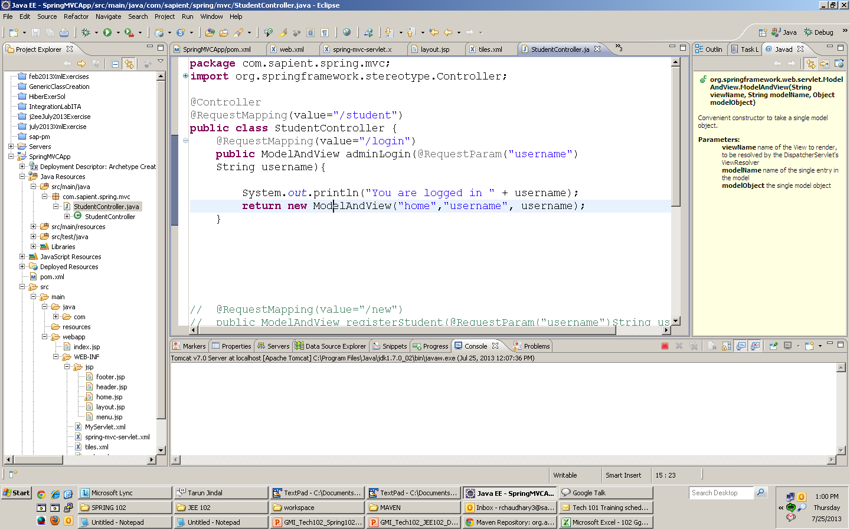
Now that we are done creating tiles definitions and configuring it for our Spring MVC application, its time to use these definitions as results.
To use a tile definition as a result in an controller we have to return the name of the definition which we have specified in the tiles.xml
Sample controller

Slide 37
Exercise
Incorporate the tiles in Registration exercise.

Slide 38
Introduction
JSTL is a jsp standard template library.
JSTL allows you to program your JSP pages using tags, rather than the commonly used scriptlet code that most JSP programmers are already accustomed to. JSTL can do nearly everything that regular JSP scriptlet code can do.

Slide 39
JSTL – How to add JSTL support to Spring MVC project?
Add the following dependencies in your pom.xml.
<dependency>
<groupId>jstl</groupId>
<artifactId>jstl</artifactId>
<version>1.2</version>
</dependency>
Once we have added jstl we need to include the tag lib URI in our jsps
<%@ taglib uri = "http://java.sun.com/jstl/core" prefix = "c"%>

Slide 40
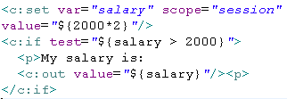
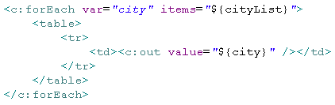
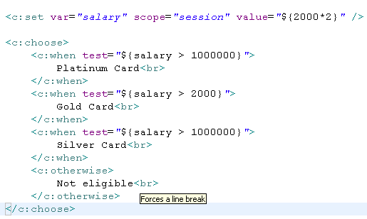
Some Code fragments to use JSTL

Slide 41
Spring - JPA Integration Exercise
(In the continuation of the earlier exercises)
Create a Application where admin should able to login using its username and password authentication needs to done using database.
Admin should be able to register new user in the system.
Admin should be able to see the list of registered user and should be able to see the details of those user.
Admin should be able to update the user.
(You need to do it using JPA and Database along with Spring MVC)

Slide 42
Recap
MVC Architecture
Spring Web MVC Features
Core Components of Spring MVC
Lifecycle of a Request in Spring MVC
Defining a Controller
Mapping Requests
View Resolvers
@ExceptionHandler annotation
Apache Tiles and Spring MVC
Introduction to JSTL

Slide 43
References
www.tutorialspoint.com/spring/spring_web_mvc_framework.htm
www.javatpoint.com/spring-3-mvc-tutorial
https://docs.spring.io/docs/Spring-MVC-step-by-step/
www.mkyong.com/tutorials/spring-mvc-tutorials/
https://dzone.com/tutorials/java/spring/spring-mvc-tutorial-1.html
For tiles
http://tiles.apache.org/tutorial/index.html
For JSTL
http://docs.oracle.com/javaee/5/tutorial/doc/bnakc.htmll

Slide 44
THANK YOU

